Slide 1
DIGITAL PORTFOLIO
STUDENT NAME: anu.p
REGISTER NO AND NMID:2224049123 & asunm1323222404923
DEPARTMENT: B.SC Computer Science
COLLEGE: COLLEGE/ UNIVERSITY: The Quaide Milleth College For Men’s

Slide 2
PROJECT TITLE STUDENT PORTFOLIO

Slide 3


AGENDA
Problem Statement
Project Overview
End Users
Tools and Technologies
Portfolio design and Layout
Features and Functionality
Results and Screenshots
Conclusion
Github Link
3/21/2024 Annual Review

Slide 4

PROBLEM STATEMENT
In today’s competitive academic and professional environment, students need a digital presence to showcase their skills, achievements, and projects.
Traditional resumes are static and often fail to reflect creativity and technical abilities.
There is a need for a dynamic, interactive, and easily accessible portfolio that highlights a student’s academic background, technical skills, personal projects, and contact information.
The challenge is to design and develop a student portfolio website using HTML, CSS, and JavaScript, which provides a professional yet user-friendly platform for students to present themselves effectively.

Slide 5

PROJECT OVERVIEW
The Student Portfolio Website is a personal web-based platform developed using HTML, CSS, and JavaScript to showcase a student’s skills, academic achievements, projects, and contact information.
The main objective of this project is to provide students with a professional online identity that goes beyond a traditional resume.
This portfolio will feature different sections such as About Me, Skills, Projects, and Contact, allowing visitors to easily navigate and learn about the student.
The inclusion of interactive JavaScript features, such as project cards and dynamic content display, makes the portfolio more engaging and user-friendly.
The website will be fully responsive, ensuring accessibility across devices like desktops, tablets and smartphones. By creating this project, students not only develop their digital portfolio but also strengthen their knowledge of front-end web development concepts.

Slide 6

WHO ARE THE END USERS?
The end users of the Student Portfolio Website include:
Recruiters and Employers: Hiring managers and recruiters who are evaluating a student’s skills, projects, and overall profile during the recruitment process.
Academic Institutions: Professors, mentors, or evaluators who want to review a student’s work, skills, and achievements for academic assessments, internships, or competitions.
Peers and Collaborators: Fellow students or collaborators who may want to connect for group projects, hackathons, or research initiatives.
General Audience: Anyone interested in learning more about the student, including friends, family, or visitors browsing personal portfolios for inspiration.

Slide 7

TOOLS AND TECHNIQUES
1.Frontend Technologies
HTML5: To create the structure of the portfolio website.
CSS3: For styling, layouts, colours, fonts, and responsive design.
JavaScript: To add interactivity (dynamic project loading, buttons, effects).
2.Development Tools
Code Editor: Visual Studio Code (or Sublime Text / Atom) for writing and editing code.
Version Control: Git for version management and GitHub for hosting the project repository.
Browser Developer Tools: For testing and debugging the website.

Slide 8
PORTFOLIO DESIGN AND LAYOUT
The design and layout of the Student Portfolio Website focus on creating a simple, professional, and responsive interface that highlights the student’s skills and achievements. The layout is divided into well-structured sections for easy navigation and readability.
1. Header Section
Contains the student’s name, title (e.g., “Web Developer | Student | Tech Enthusiast”), and a short tagline.
Simple and clean design with attractive background color or image.
2. Navigation Bar
A fixed menu bar with links to all major sections: About, Skills, Projects, Contact.
Ensures smooth navigation and a user-friendly experience.
3. About Section
A short introduction about the student.
Optionally includes a profile photo for personalization.
4. Skills Section
List of technical and soft skills.
Can include skill bars or icons for better visualization.
8

Slide 9
5. Projects Section
Displays the student’s projects using cards or tiles.
Each card includes project title, short description, and possibly links (GitHub/demo).
6. Contact Section
Provides contact information such as email, phone, and social media links.
Includes a simple button or form for interaction.
7. Footer Section
Contains copyright text, quick links, and optional social media icons.
8. Layout Characteristics
Responsive Design: Adjusts to desktops, tablets, and mobile devices.
Consistent Theme: Uses uniform fonts, colours, and spacing.
Interactive Elements: Hover effects, dynamic project loading, and optional animations.

Slide 10
FEATURES AND FUNCTIONALITY
Features:
Responsive layout using CSS grid.
JavaScript dynamically loads projects.
Interactive button for fun.
Sections: About, Skills, Projects, Contact.
Functionality:
Responsive Design: Works seamlessly on desktop, tablet, and mobile devices.
Interactive Elements:
JavaScript-based project loading.
Hover effects and animations for a modern look.
Button click events (e.g., "Thank you for visiting" message).
Navigation Bar: Smooth scrolling and easy access to different sections.
Dark Mode (Optional): Toggle between light and dark themes for better accessibility.
Deployment Ready: Can be hosted on GitHub Pages, Netlify, or Vercel for public access.

Slide 11

RESULTS AND SCREENSHOTS
The Student Portfolio Website was successfully designed and developed using HTML, CSS, and JavaScript. The project achieved its main objective of providing students with a professional, responsive, and interactive platform to showcase their academic background, skills, and projects.
Results Achieved:
Responsive Design: The website adapts smoothly to different devices (desktop, tablet, and mobile).
Interactive UI: Projects are displayed dynamically, and interactive buttons provide a better user experience.
Professional Layout: Clean and organized sections (About, Skills, Projects, Contact) improve readability.
Ease of Access: The portfolio can be deployed online for recruiters, peers, and institutions to view anytime.
Practical Learning: Developing this project strengthened knowledge of web development technologies (HTML, CSS, JavaScript).
3/21/2024 Annual Review
11

Slide 12
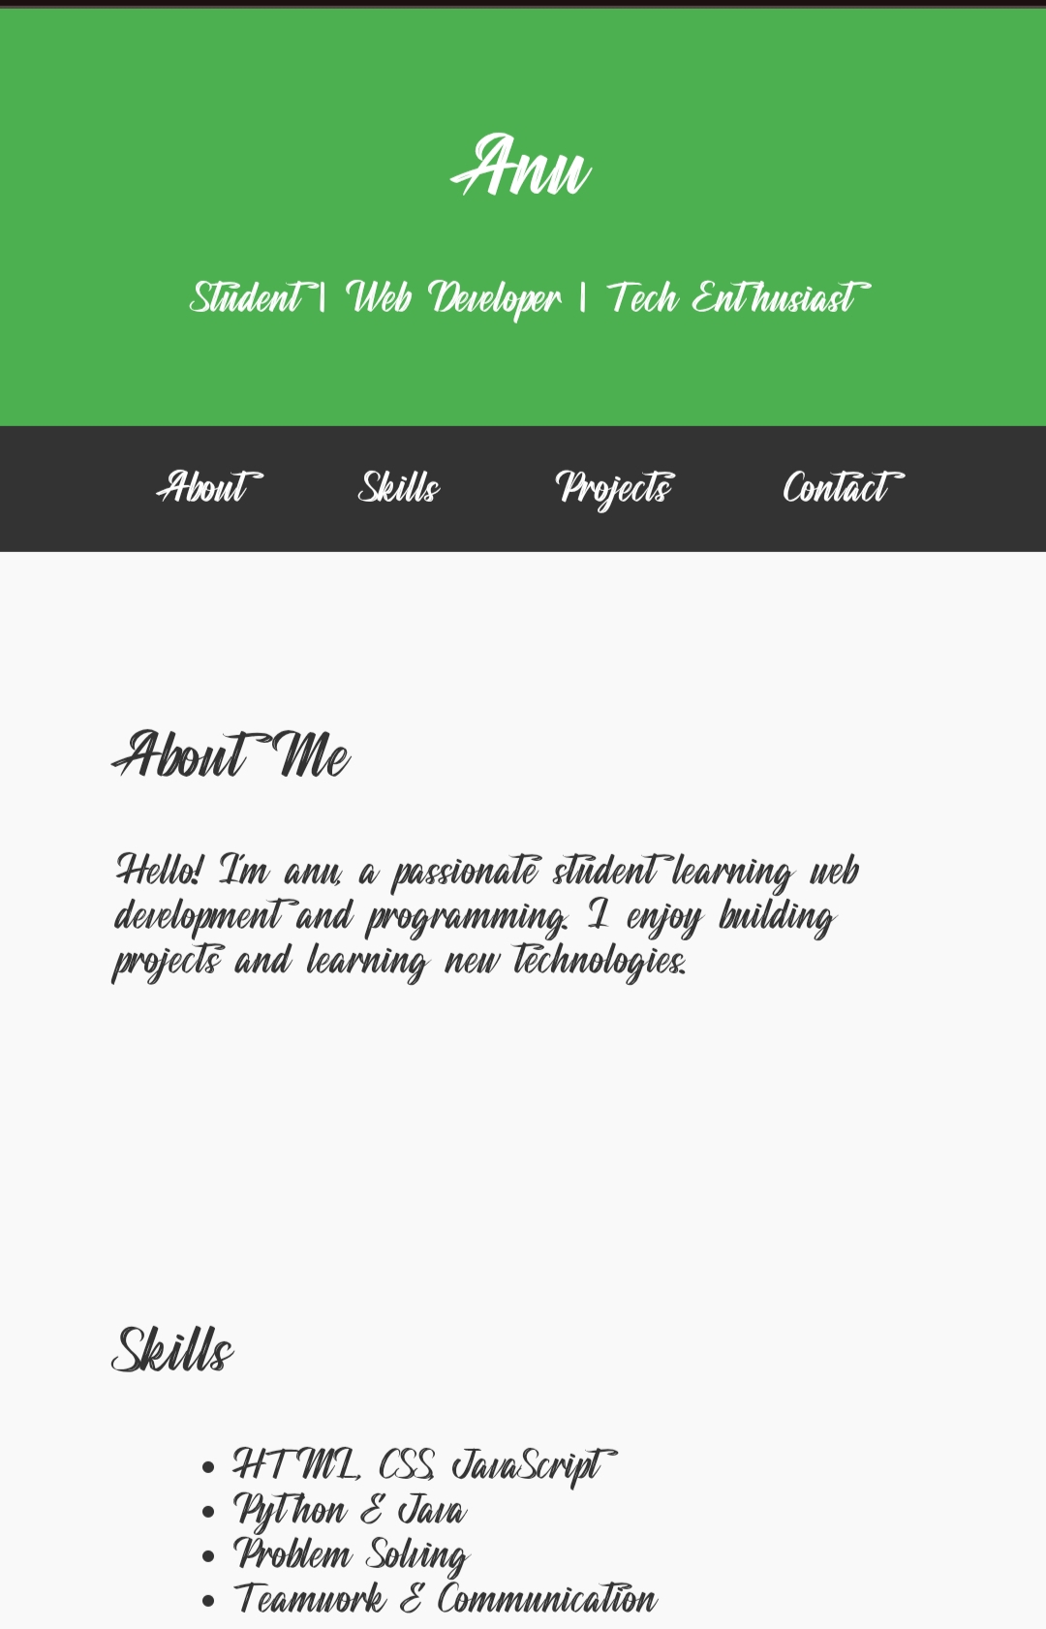
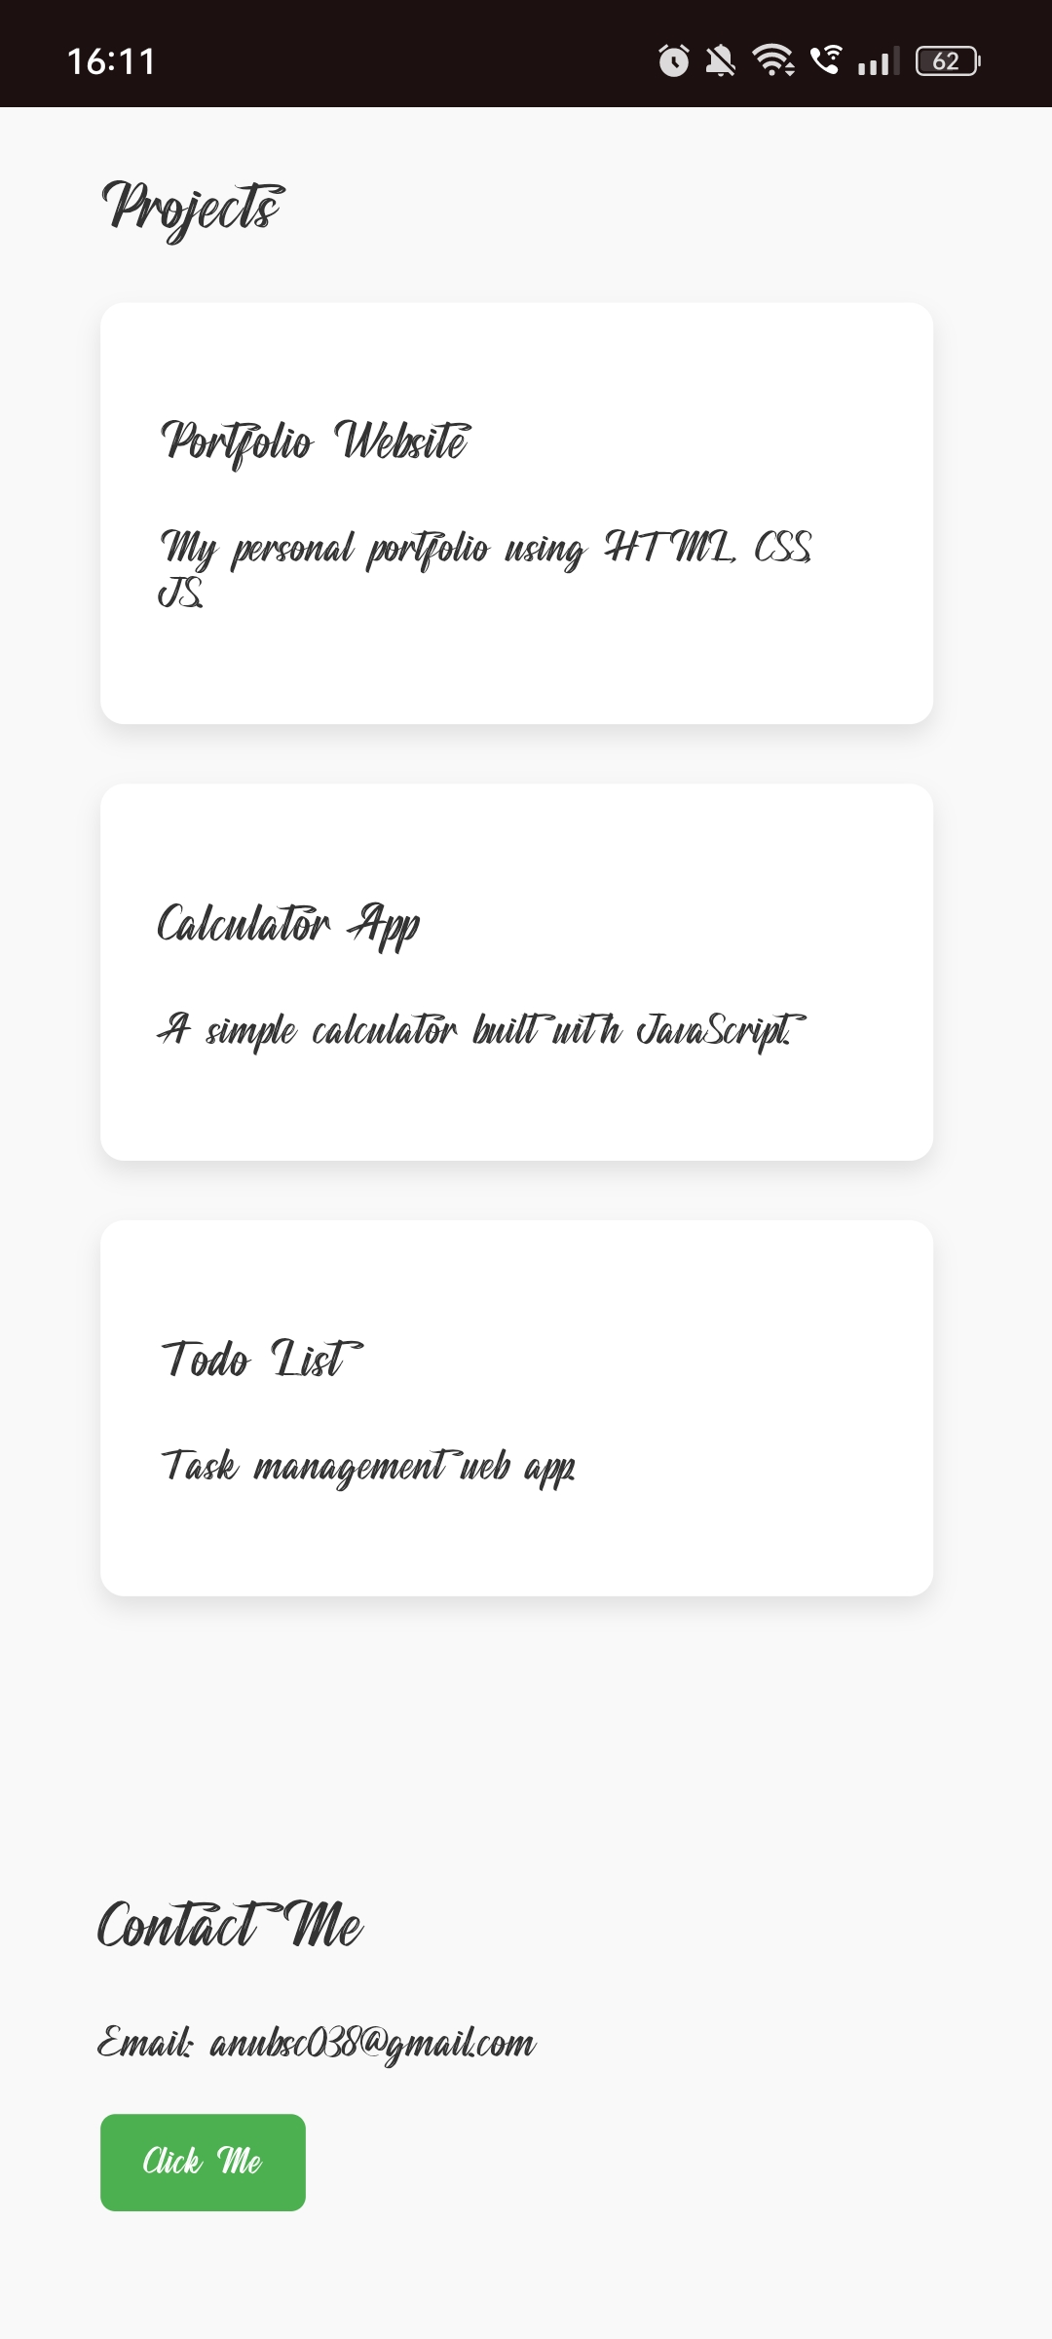
SCREENSHOT:

Slide 13
CONCLUSION
The Student Portfolio Website Project successfully demonstrates the use of HTML, CSS, and JavaScript to design and develop a personal portfolio that is simple, professional, and responsive.
The project fulfills its primary objective of providing students with an effective digital platform to showcase their academic background, technical skills, projects, and contact information.
This project can be further enhanced in the future by integrating advanced features such as a dark mode toggle, project filtering, animations, and a contact form with backend support.
Overall, the portfolio website is a practical, meaningful, and valuable project for students to showcase both their skills and their creativity.
13

